Slide 1

Windows CE System
Frequently Asked Question
School of Software Engineering

Slide 2
Index
Windows CE Menu
Connect to Emulator without Ethernet
EVC can NOT display Chinese Chars

Slide 3
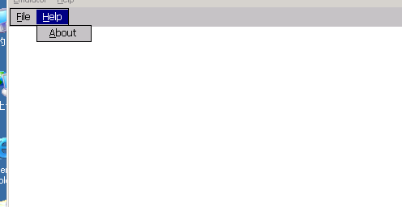
1. How to create and use menu in Windows CE Apps

Slide 4
Problem description
The menu resource can be inserted and edited into .rc file
Desktop Windows API does NOT work
  CreateMenu
  SetMenu

Slide 5
Problem Root Cause
The GUI Shell of Windows CE system is somewhat different with desktop window, the UI elements of Pocket PC and Smartphone are different.
Windows CE implements the menu API as Common control, named Command Bar.

Slide 6
Solution
#include <commctrl.h>
#pragma comment(lib, “Commctrl.lib”) // link the static library
……
case WM_CREATE:
hwndCB = CommandBar_Create(hInst, hWnd, 1);
CommandBar_InsertMenubar(hwndCB, hInst, IDM_MENU, 0);
CommandBar_AddAdornments(hwndCB, 0, 0);
case WM_DESTROY:
CommandBar_Destroy(hwndCB);

Slide 7
Related resources
Programming element | Description
CommandBar_AddBitmap | This function adds one or more images to the list of button images available for use in the command bar.
CommandBar_AddAdornments | This function adds the Close button (X) to the command bar.
CommandBar_InsertComboBox | This function inserts a combo box into the command bar.
CommandBar_InsertMenubar | This function inserts a menu bar into the command bar.
CommandBar_InsertMenubarEx | This function inserts a menu into a command bar.
CommandBar_Create | This function instantiates a new command bar.
CommandBar_DrawMenuBar | This function repositions and redraws the command bar after a menu in the command bar has been modified.
CommandBar_GetMenu | This function retrieves the handle to a menu on the command bar.
CommandBar_Height | This function retrieves the height of the command bar in pixels.
CommandBar_Show | This function shows or hides the command bar.

Slide 8
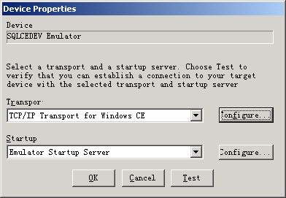
2. How to use EVC to connect to emulator if my PC has no Ethernet card

Slide 9
Problem description & cause
EVC need to use TCP/IP to connect to connect to emulator
Your PC must have an available Ethernet connection
Platform manager can NOT connect to device without Ethernet connection

Slide 10
Solution : Install Microsoft Loopback Adapter
控制面板 -> 添加硬件 -> 手动选择 -> 网络适配器 -> Microsoft -> Microsoft Loopback Adapter

Slide 11
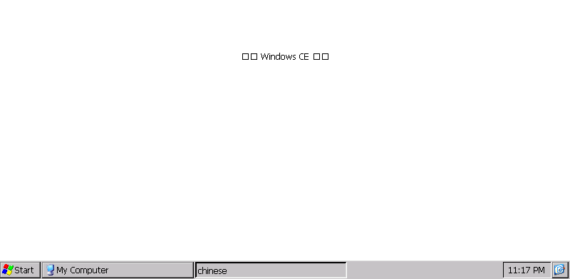
3. EVC can not display Chinese Characters

Slide 12
Problem description & cause
The default Standard SDK is built with the English language.
There are no Chinese font installed at all.

Slide 13
Solution : Build your own Platform with Chinese and export your own SDK
From PB, Platform -> Setting -> Locale
Be sure that the default language is Simplified Chinese
Export SDK and install it.

Slide 14
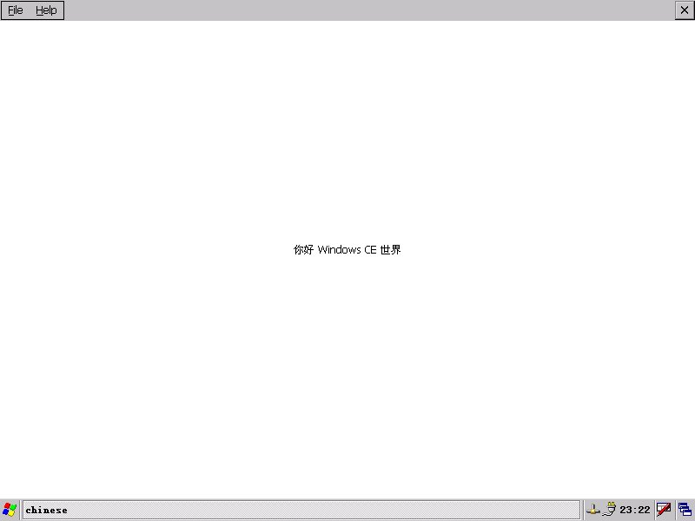
Correct Result

